Slide 1

Module 12: Implementing Siebel Analytics Cluster Servers
0/5
Analytics: Advanced Server Architect

Slide 2
Module Objectives
After completing this module you will be able to:
  Identify the steps and requirements for setting up Siebel Analytics Cluster Servers
Why you need to know:
  Performance or availability requirements may mandate using multiple servers to support Siebel Analytics

Slide 3
Business Challenge and Solution
Challenge: Running Siebel Analytics on a single server may present performance or availability issues
  A single server may not be able to process all of the requests in a timely manner
  Network bandwidth may prevent users from accessing the server, or from receiving query results quickly enough
  If the server goes down, Siebel Analytics is unavailable
Solution: Implement multiple Siebel Analytics Servers in a Siebel Analytics Cluster Server
  Multiple servers process requests, improving performance
  If one server goes down, other servers are still running, increasing server availability

Slide 4
Siebel Analytics Cluster Servers
Allow up to sixteen Siebel Analytics Servers in a single domain to act as a single server
  Servers share requests from multiple Siebel Analytics clients
Improve performance by allowing multiple servers to share requests and processing
Cluster Server
Client
Siebel
Analytics
Server
Siebel
Analytics
Server
Client
Web Server
Analytics Web
Siebel
Analytics
Server
Siebel
Analytics
Server
Client

Slide 5
Components of a Cluster Server
0/6
Server Manager (UNIX Only)
Primary Cluster Controller
Secondary Cluster Controller
Master Server
Repository Publishing Directory
Cluster Manager

Slide 6
Server Manager (UNIX Only)
1/6
Is a subprocess that runs as part of the nqscomgateway.exe process
Controls the start/stop/restart of the nqsserver.exe process
Port number must be specified in the NQClusterConfig.INI file
  Use the SERVER_MANAGER_PORT parameter to specify port number

Slide 7
Primary Cluster Controller
2/6
Is the primary component of a cluster server
Monitors status of resources and performs session assignments
Supports detection of server failures and failover for ODBC clients of failed servers
Is on a dedicated machine or is combined with an Analytics Server on a machine
Cluster Server
Primary
Cluster
Controller
Master
Server
The primary Cluster Controller routes requests to servers
Secondary
Cluster
Controller
Siebel
Analytics
Server

Slide 8
Secondary Cluster Controller
3/6
Provides backup controller capability in case the primary Cluster Controller is unavailable
  Specifying a secondary Cluster Controller is optional, but recommended
May be on the same machine as a Siebel Analytics Server
Cannot be on the same machine as the primary Cluster Controller
Cluster Server
Primary
Cluster
Controller
Master
Server
Secondary
Cluster
Controller
Siebel
Analytics
Server
The secondary Cluster Controller provides backup for the primary controller

Slide 9
Master Server
4/6
Is a clustered Analytics Server to which the Administration Tool connects for online repository changes
Provides a single point of entry for modifying the repository
  Prevents multiple servers from attempting to modify the repository simultaneously
Cluster Server
Primary
Cluster
Controller
Master
Server
The master server is the only server to which the Administration Tool connects
Secondary
Cluster
Controller
Siebel
Analytics
Server

Slide 10
Repository Publishing Directory
5/6
Is a directory shared by all Analytics Servers in a cluster
  All servers must have read access to this directory
Holds master copies of repositories edited in online mode
Is read by Analytics Servers on startup for any repository changes
Is only edited by the master server
  Only the master server requires write access to this directory
Cluster Server
The master server is the only server that requires write access to the repository publishing directory
Primary
Cluster
Controller
Master
Server
Repository
Publishing
Directory
Secondary
Cluster
Controller
Siebel
Analytics
Server
All servers in the cluster require read access to the repository publishing directory

Slide 11
Using the Repository Publishing Directory
5/6
On startup, each Analytics Server in the cluster examines the repository publishing directory for any updated repository
  Compares date and timestamps of repository publishing directory repositories to its local repositories
  Copies newer repositories from repository publishing directory to its local repository directory
Caveats:
  New repositories are not copied; they must be manually propagated to all servers in the cluster
  Time of day clocks must be synchronized across all Analytics Servers and Cluster Controllers in a cluster

Slide 12
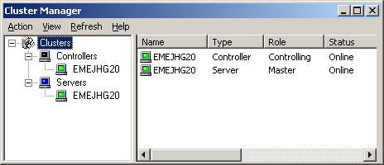
Cluster Manager
6/6
Is available in the Administration Tool when a repository is open in online mode
Allows for:
  Viewing cluster information
  Managing clustered servers
  Viewing sessions and caches for each individual server
The Cluster Manager shows available servers and controllers and their status

Slide 13
Steps to Implement a Cluster Server
0/6
1. Install the Cluster Controller Component
2. Edit Configuration Files
3. Set Up ODBC Data Source for Clustering
4. Copy NQClusterConfig.INI to All Servers in the Cluster
5. Start the Servers
6. Test Clustering

Slide 14
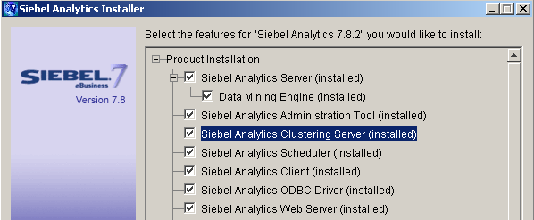
1. Install the Cluster Controller Component
1/6
Install component on machines that will host Cluster Controllers
Select a setup type that includes the Siebel Analytics Clustering Server
  Select Complete or Siebel Analytics Server setup type to combine an Analytics Server with a Cluster Controller
  Alternatively, use the Custom setup type to select the clustering server component manually to add to an existing installation

Slide 15
2. Edit Configuration Files
2/6
Edit NQSConfig.INI on each Siebel Analytics Server to specify:
  CLUSTER_PARTICIPANT to indicate that the server is part of a cluster
  REPOSITORY_PUBLISHING_DIRECTORY to specify the location of the repository publishing directory
  REQUIRE_PUBLISHING_DIRECTORY to specify whether the server requires the repository publishing directory to be available to start up
    Server will not detect repository changes unless publishing directory is available

Slide 16
2. Edit Configuration Files Continued
2/6
Edit NQClusterConfig.INI for both Siebel Analytics Servers and Cluster Controllers to specify:
  ENABLE_CONTROLLER to specify whether the machine is a Cluster Controller
  PRIMARY_CONTROLLER to specify which machine is the primary Cluster Controller
  SECONDARY_CONTROLLER to specify which machine is the secondary Cluster Controller
  SERVERS to specify which servers belong to the cluster
  MASTER_SERVER to specify which machine is the master server
    This machine requires write access to the repository publishing directory
  SERVER_POLL_SECONDS to specify the frequency of heartbeat messages between the Cluster Controller and each server in the cluster
    Default is five seconds
    Servers with no heartbeat are assumed to be down

Slide 17
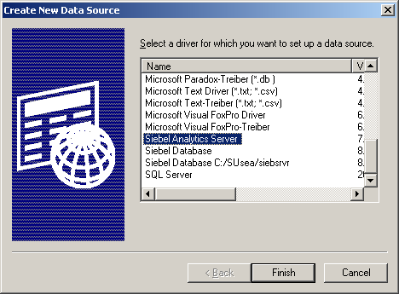
3. Set Up ODBC Data Source for Clustering
3/6
Create a new System DSN ODBC connection using the Siebel Analytics Server driver

Slide 18
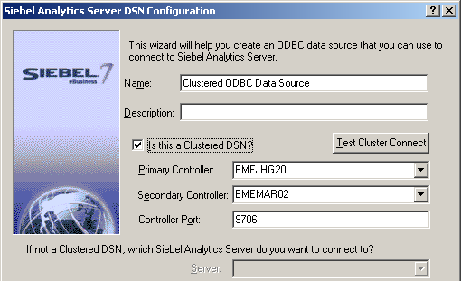
3. Set Up ODBC Data Source for Clustering Continued
3/6
Specify that this is a clustered DSN
Specify primary and secondary Cluster Controllers
Check this checkbox for clustered DSNs
Specify primary and secondary Cluster Controllers and port number

Slide 19
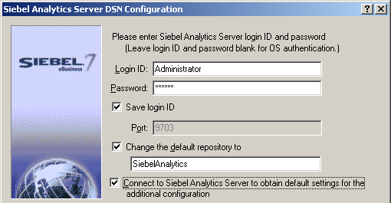
3. Set Up ODBC Data Source for Clustering Continued
3/6
Specify repository login ID and password
Specify default repository and other connection options
All clients must then use the clustered DSN to communicate with the cluster
Specify Siebel Analytics Server login ID and password
Set other options as desired

Slide 20
4. Copy NQClusterConfig.INI to All Servers in the Cluster
4/6
Every Analytics Server and Cluster Controller in the cluster must have an identical copy of NQClusterConfig.INI in their Config directory
For first-time deployment, also copy repositories to all servers

Slide 21
5. Start the Servers
5/6
Start an Analytics Server
Start a Cluster Controller
On Windows:
  Use Cluster Manager in the Siebel Analytics Administration Tool to start others
On Unix:
  Start others manually

Slide 22
6. Test Clustering
6/6
Use Siebel Analytics Answers or Siebel Analytics Delivers to test clustering
  Examine NQServer.log on Analytics Servers and NQCluster.log on Cluster Controllers to verify startup and connectivity
  Run multiple queries and examine server logs for queries to ensure that multiple servers are receiving requests
  Shut down one server and verify successful failover

Slide 23
Cluster Server Chronology
1. On startup, each Siebel Analytics Server reads NQSConfig.INI to determine whether it is part of a cluster
2. Each Analytics Server that is part of a cluster reads NQClusterConfig.INI
3. Each Cluster Controller that is part of a cluster reads NQClusterConfig.INI
4. Each Analytics Server verifies the presence of an active, operational Cluster Controller
5. Cluster Controllers start exchanging heartbeat messages
6. Analytics Servers verify access to the repository publishing directory
7. Cluster Controllers start exchanging heartbeat messages with Analytics Servers

Slide 24
Cluster Considerations
Siebel Analytics Servers in clusters do not share a common connection pool
  Each server communicates with the back-end database using the connection defined in the Connection Pool of the repository
Siebel Analytics Servers each maintain their own cache
  Clustered servers do not share a common cache

Slide 25
Summary
This module showed you how to:
  Identify the steps and requirements for setting up Siebel Analytics Cluster Servers

Slide 26
Lab
In the lab you will:
  Answer questions regarding clustering of Siebel Analytics Server components

